Slide 1
Pre-work
You will have pre-work each week and we will assume you have done this

Slide 2
Lean UX is 3 things
This is a process change for designers and product teams.
It’s a culture change that lets us approach our work with humility; we acknowledge that our initial solutions will probably be wrong and use many sources of insight to continuously improve our thinking.
It’s also a way of organizing and managing software design and development teams to be more inclusive, collaborative, and transparent.

Slide 3
Foundations
User Experience design
Design Thinking
Agile Software Development
Lean Startup with Minimal Viable Product

Slide 4
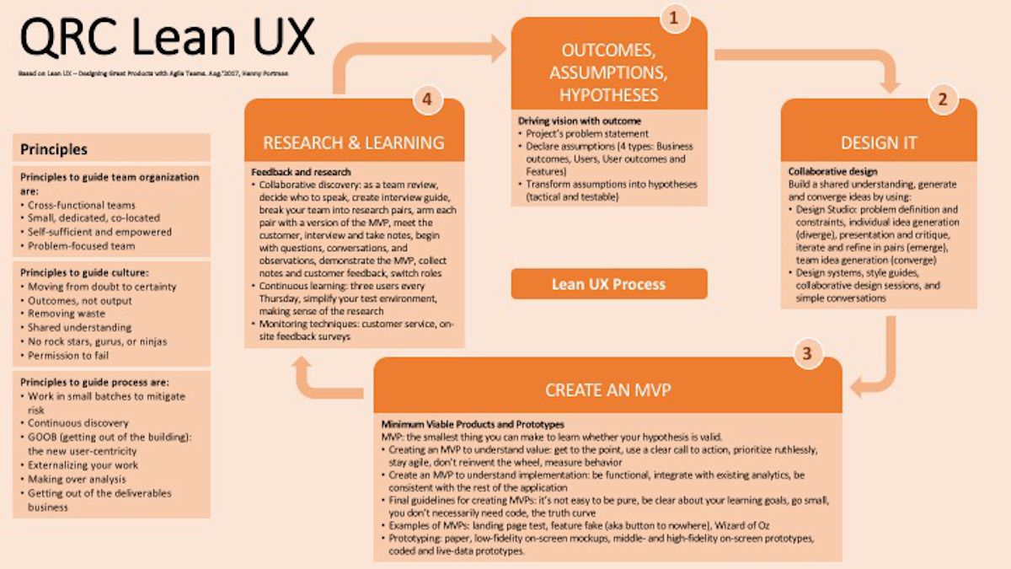

Slide 5
Process
Lean or waterfall?
Sub-processes eg StandUps
These have some set steps:
What did you do yesterday/last week?
What will you do today/this week?
What blockers in your work?

Slide 6
Team Charter
Fill this out when form team
What are the goals of your development work.
What outcome do you want.
What are your commitments to the team
These form your KPI or Key Performance Indicators

Slide 7
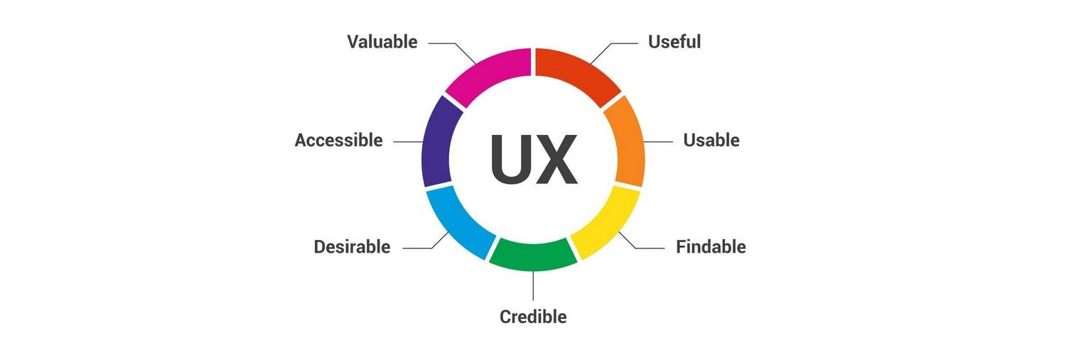
Basics of UX
Notes:
Metrics to evaluate your work

Slide 8
How are you going to learn all this
Understand this will be a lot of learning by you, so what is the way you learn? The four main learning styles are visual, auditory, reading/writing, and kinesthetic (or hands-on). For most people, one of these methods will work best, but it's also possible for a combination of different styles to be effective.
https://vark-learn.com/the-vark-questionnaire/

